Slide 1
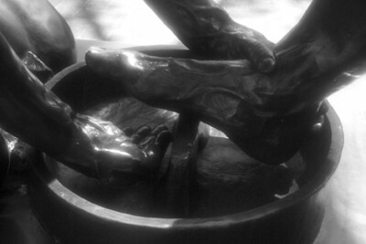
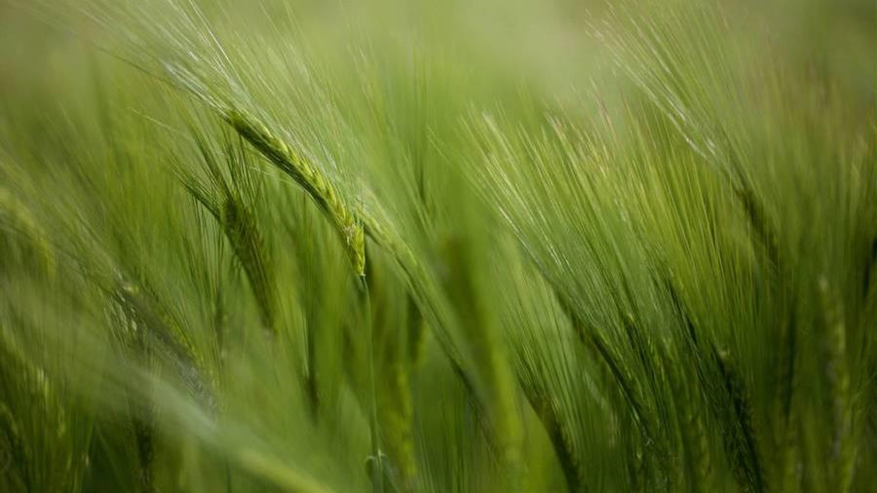
Second breakfast: Serving I give you a new commandment, that you love one another. Just as I have loved you, you also should love one another.

Slide 2
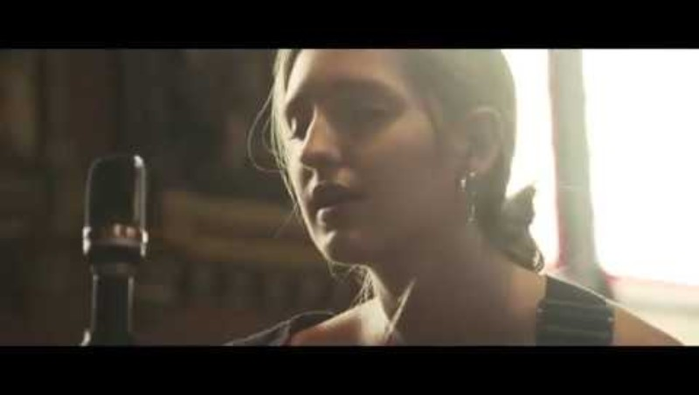

Slide 3
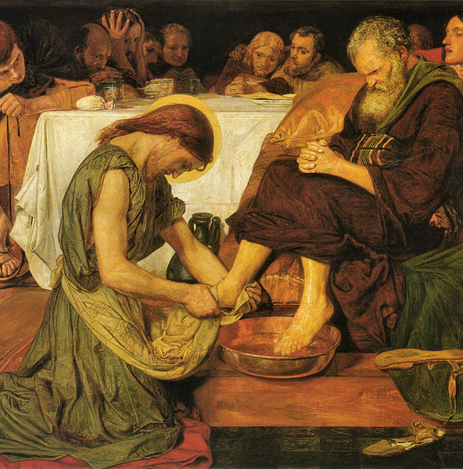
And during supper, Jesus, knowing that the Father had given all things into his hands and that he had come from God and was going to God, got up from supper, took off his outer robe, and tied a towel around himself. Then he poured water into a basin and began to wash the disciples’ feet and to wipe them with the towel that was tied around him. – John 13.3-5

Slide 4
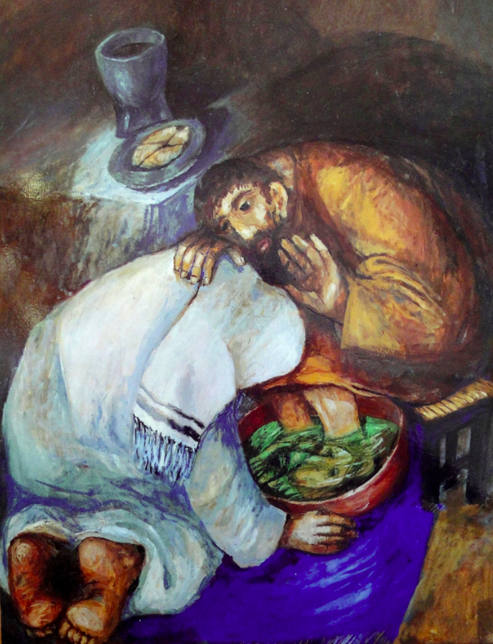
After he had washed their feet, had put on his robe, and had reclined again, he said to them, “do you know what I have done to you? You call me teacher and lord, and you are right, for that is what I am. So if I, your lord and teacher, have washed your feet, you also ought to wash one another’s feet. For I have set you an example, that you also should do as I have done to you. Very truly, I tell you, slaves are not greater than their master, nor are messengers greater than the one who sent them. If you know these things, you are blessed if you do them. John 13.12-17

Slide 5
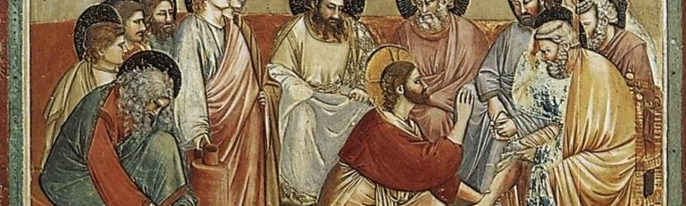
Why?
Not because it was particularly attractive or he “felt like it.” (He was in the midst of being heartbroken and rejected and betrayed.)
Not because it would impress anyone (it didn’t)
It was needed – physically and metaphorically
It was an act of loving service – and he so badly wanted his disciples to see and remember – this is how we’re meant to live:
“I give you a new commandment, that you love one another.
Just as I have loved you, you also should love one another.
By this everyone will know that you are my disciples,
if you have love for one another.”

Slide 6
Table talk
What could we be “cleansed of” as we see Jesus washing feet?
Think of a time when you didn’t feel like “serving” but did anyway and were glad you did. Share a story?
Think of a time when someone served you and it made a difference. Share a story?

