Slide 1
Compassion for All:
A Sign of the Spirit of Hope
St. Croix Church
May 3, 2026
W. Thiessen

Slide 2
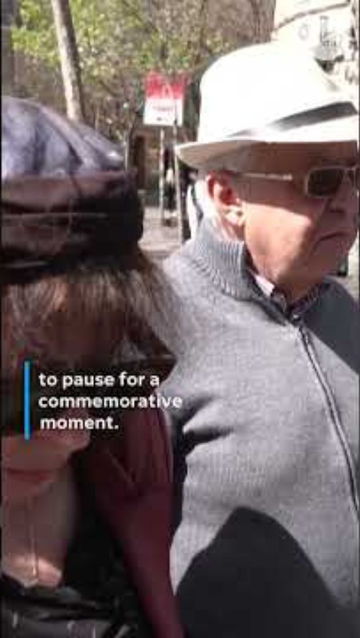
Consider:
Israel’s siren to mark holocaust memorial day

Slide 3
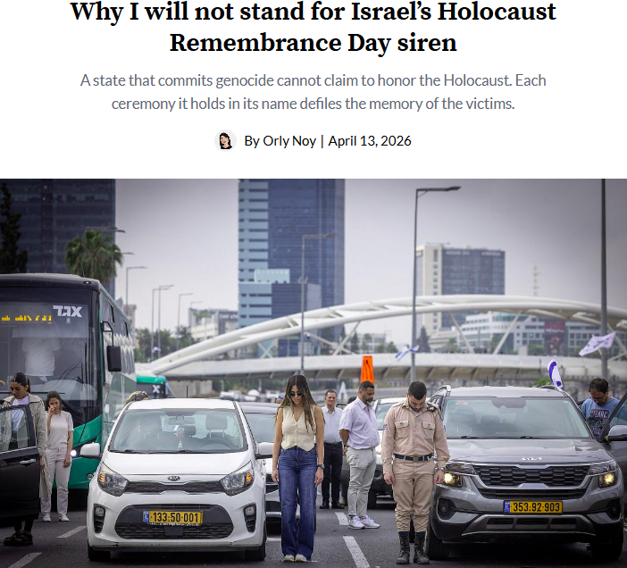
Paradox:
- powerful ritual of healing or manipulated justification for genocide?
“It has long been clear to me that the memory of the Holocaust, as far as Israel is concerned, is no more than a manipulative tool that allows it to demand unlimited impunity….
This year, I will not stand for the siren. But I will remain bound to the commandment its memory placed on me: never to forget what human hatred, superiority, indifference, and ignorance can produce, and never stop fighting them.
– Orly Noy (Israeli journalist)

Slide 4

An alternative?
Ritual of inclusion & reconciliation
Palestinians and Israelis sharing stories of pain and hope (& Music)

Slide 5
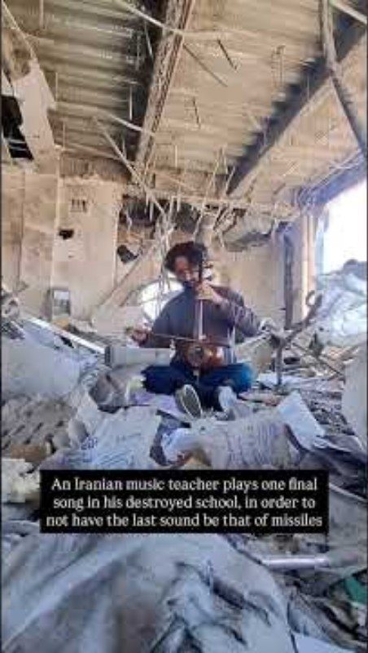
Healing ritual that is one-sided and still conducive to peace

Slide 6
Compassion for all
(Be like God, like Jesus)
Do to others as you would have them do to you.
“If you love those who love you, what credit is that to you? For even sinners love those who love them. If you do good to those who do good to you, what credit is that to you? For even sinners do the same. If you lend to those from whom you expect to receive payment, what credit is that to you? Even sinners lend to sinners, to receive as much again. Instead, love your enemies, do good, and lend, expecting nothing in return. Your reward will be great, and you will be children of the Most High, for he himself is kind to the ungrateful and the wicked. Be merciful, just as your Father is merciful.

Slide 7
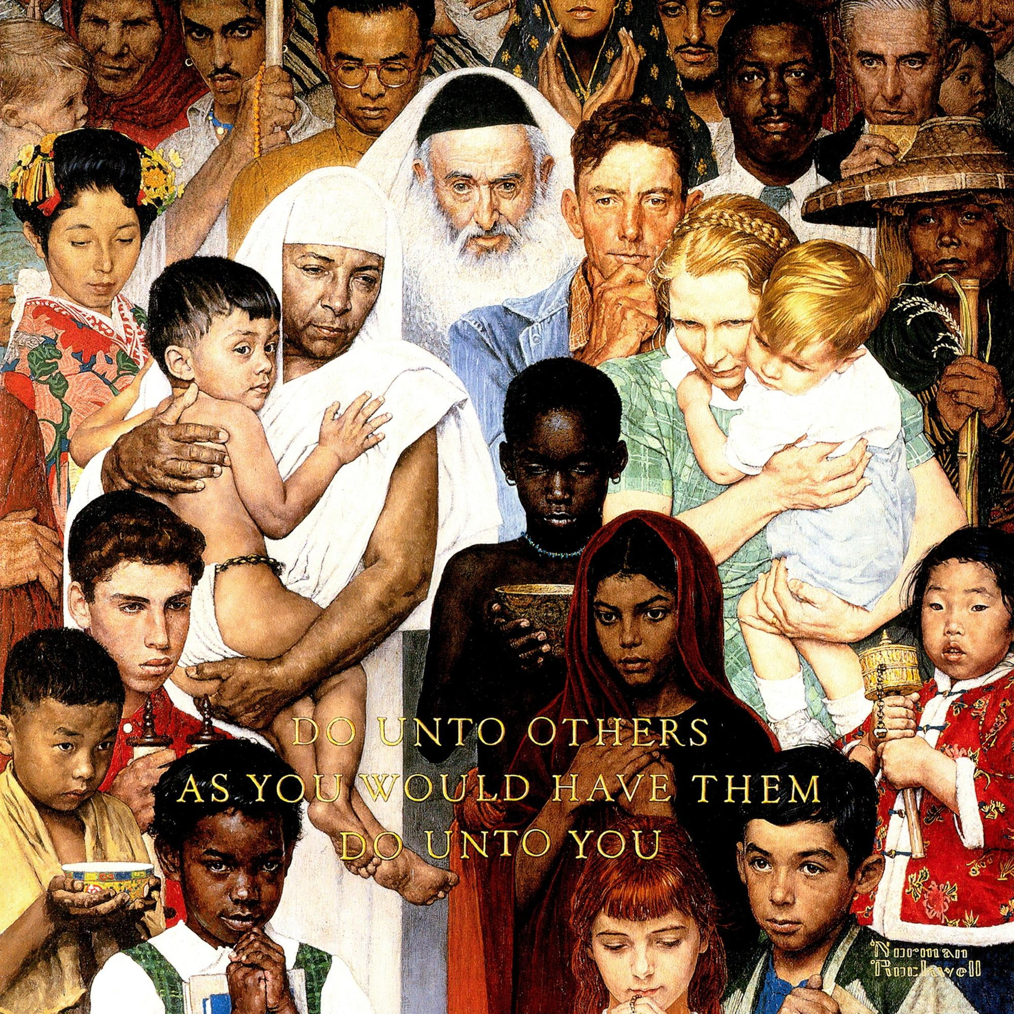

Slide 8
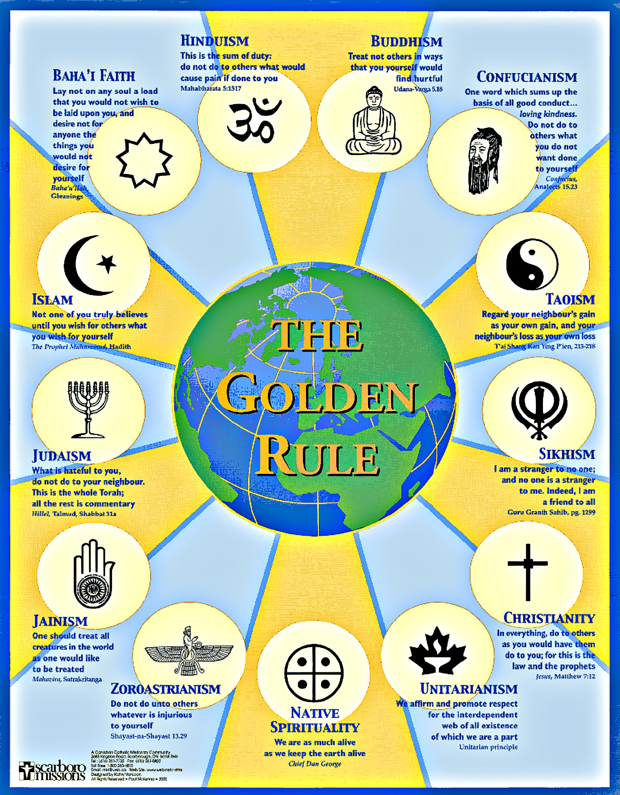
Near the heart of most spiritual tradition

Slide 9
John 14.26-27
But the Advocate, the Holy Spirit, whom the Father will send in my name, will teach you everything and remind you of all that I have said to you. Peace I leave with you; my peace I give to you. I do not give to you as the world gives. Do not let your hearts be troubled, and do not let them be afraid.

Slide 10
