Slide 1
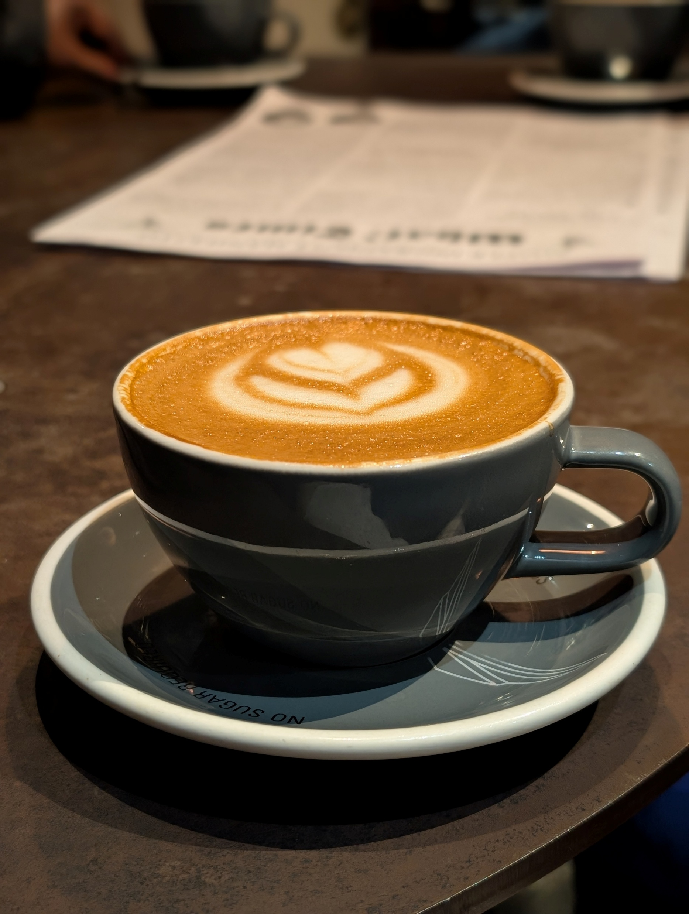
Small Things With Great Love
Sunday, September 6th, 2026
St. Croix Church

Slide 2
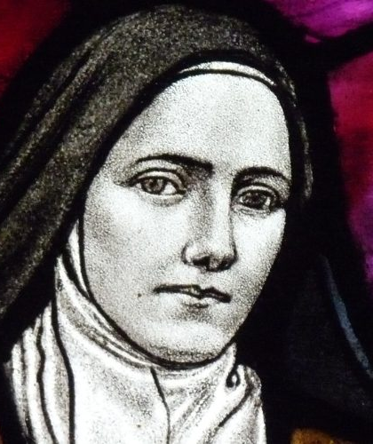
"In this life we cannot do great things. We can only do small things with great love."
Saint Thérèse of Lisieux

Slide 3
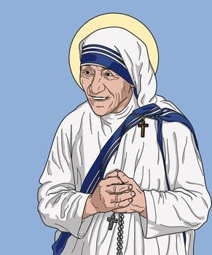
“We can do no great things, only small things with great love”
St. Mother Teresa of Calcutta

Slide 4
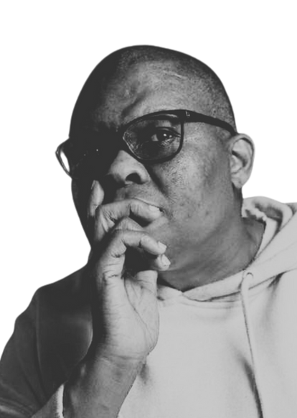
“We do not gather around the colonial wound to study it, we have to recognize that we are in it.
We are born inside this wound.”
BUYISIWE POKIE PUTU (Pokie) director of afro feminist-womanist solidarity & operations manager

Slide 5
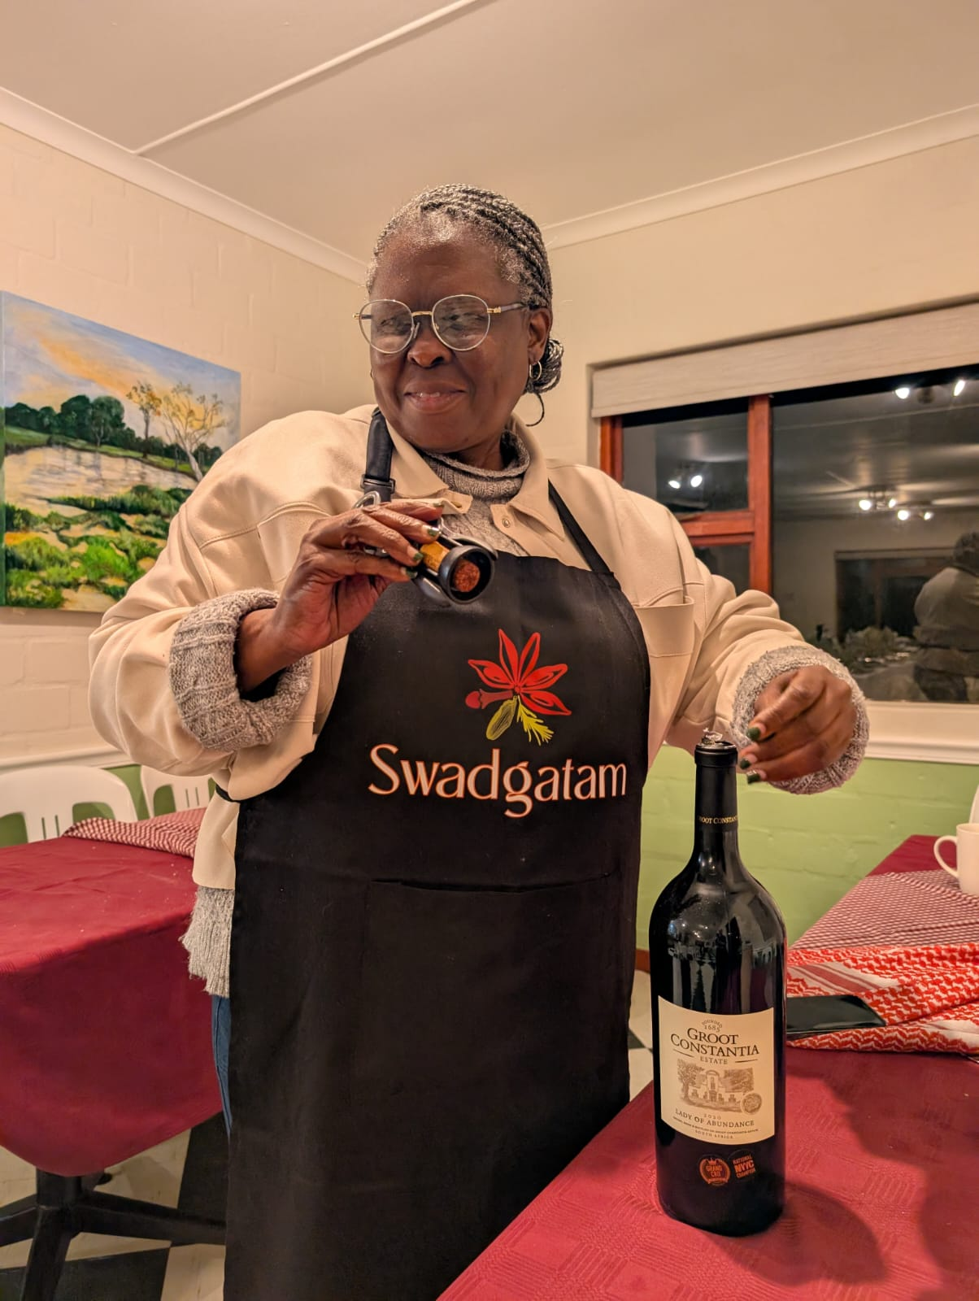

Slide 6
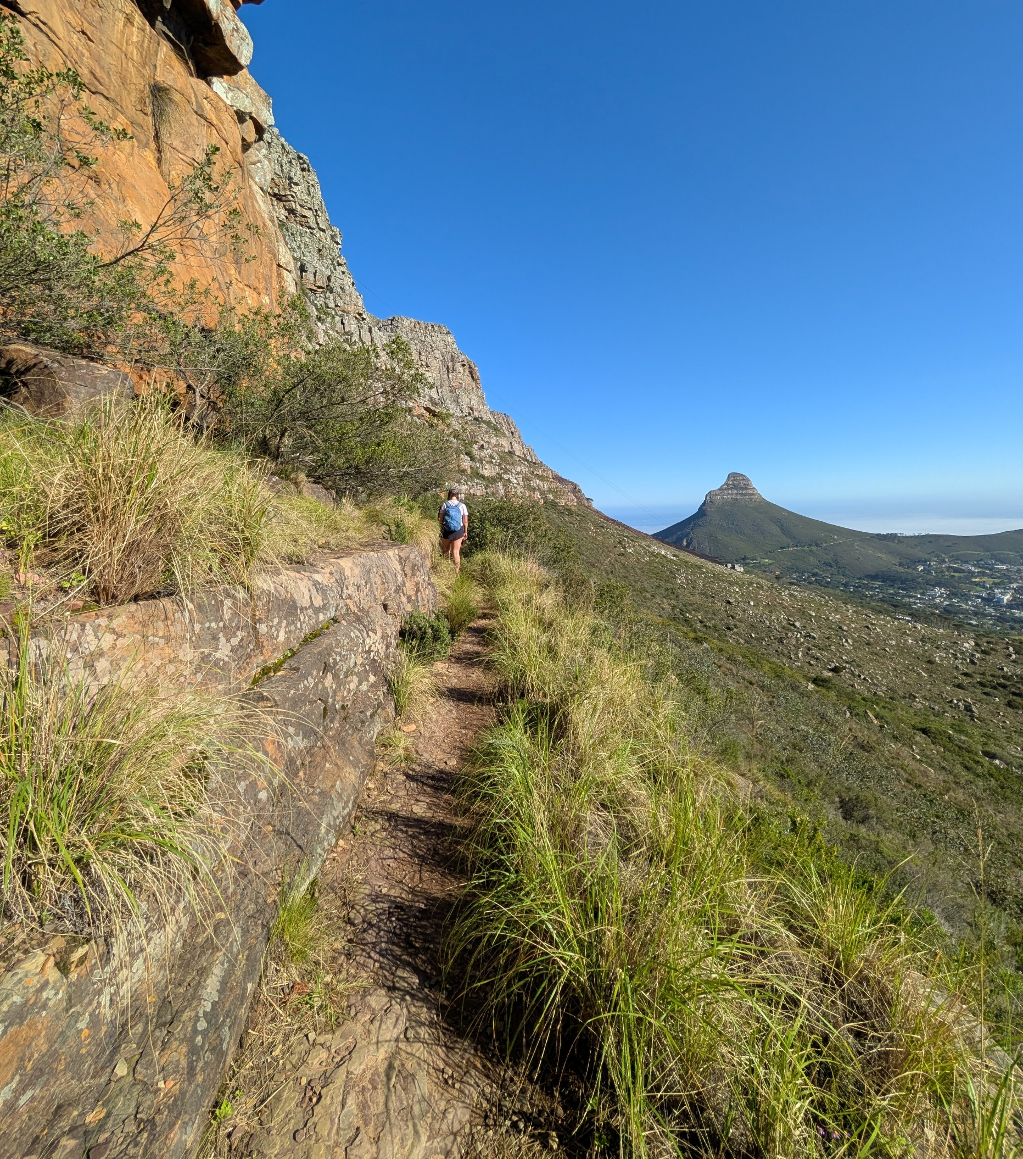
“While tourists simply pass through a place, pilgrims, in contrast, allow a place to pass through them, making the labour for liberation one which we carry together.”

Slide 7
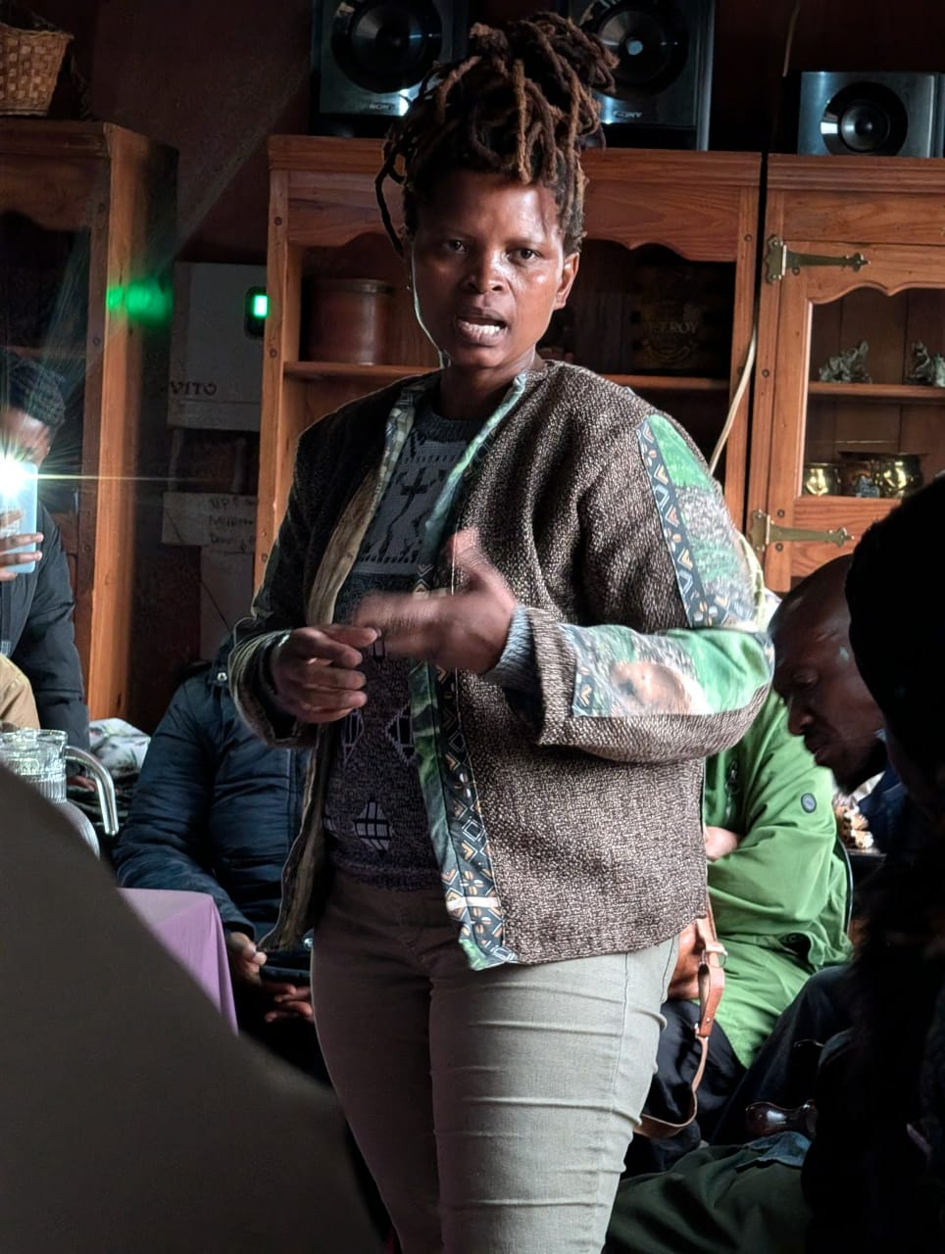
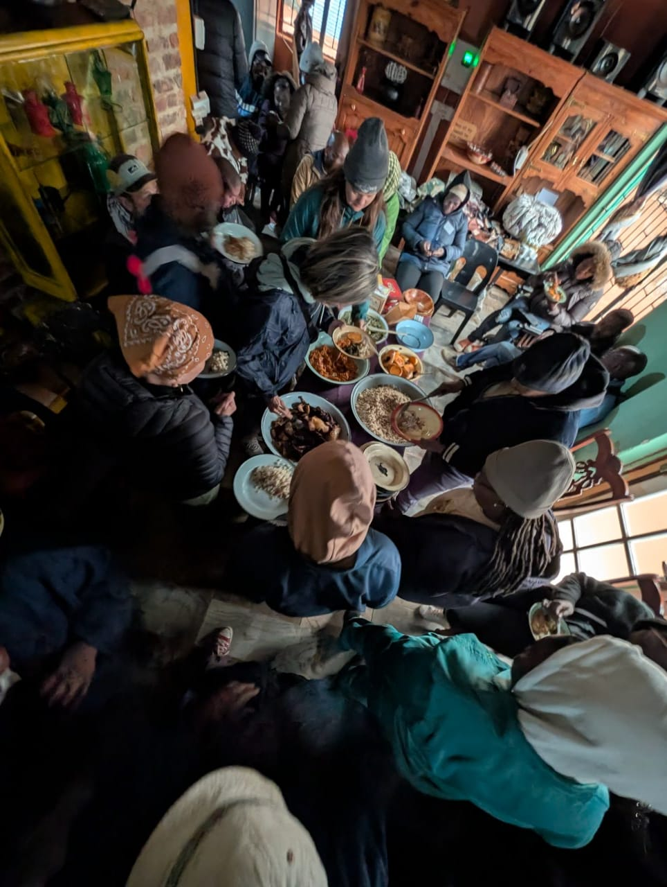

Slide 8
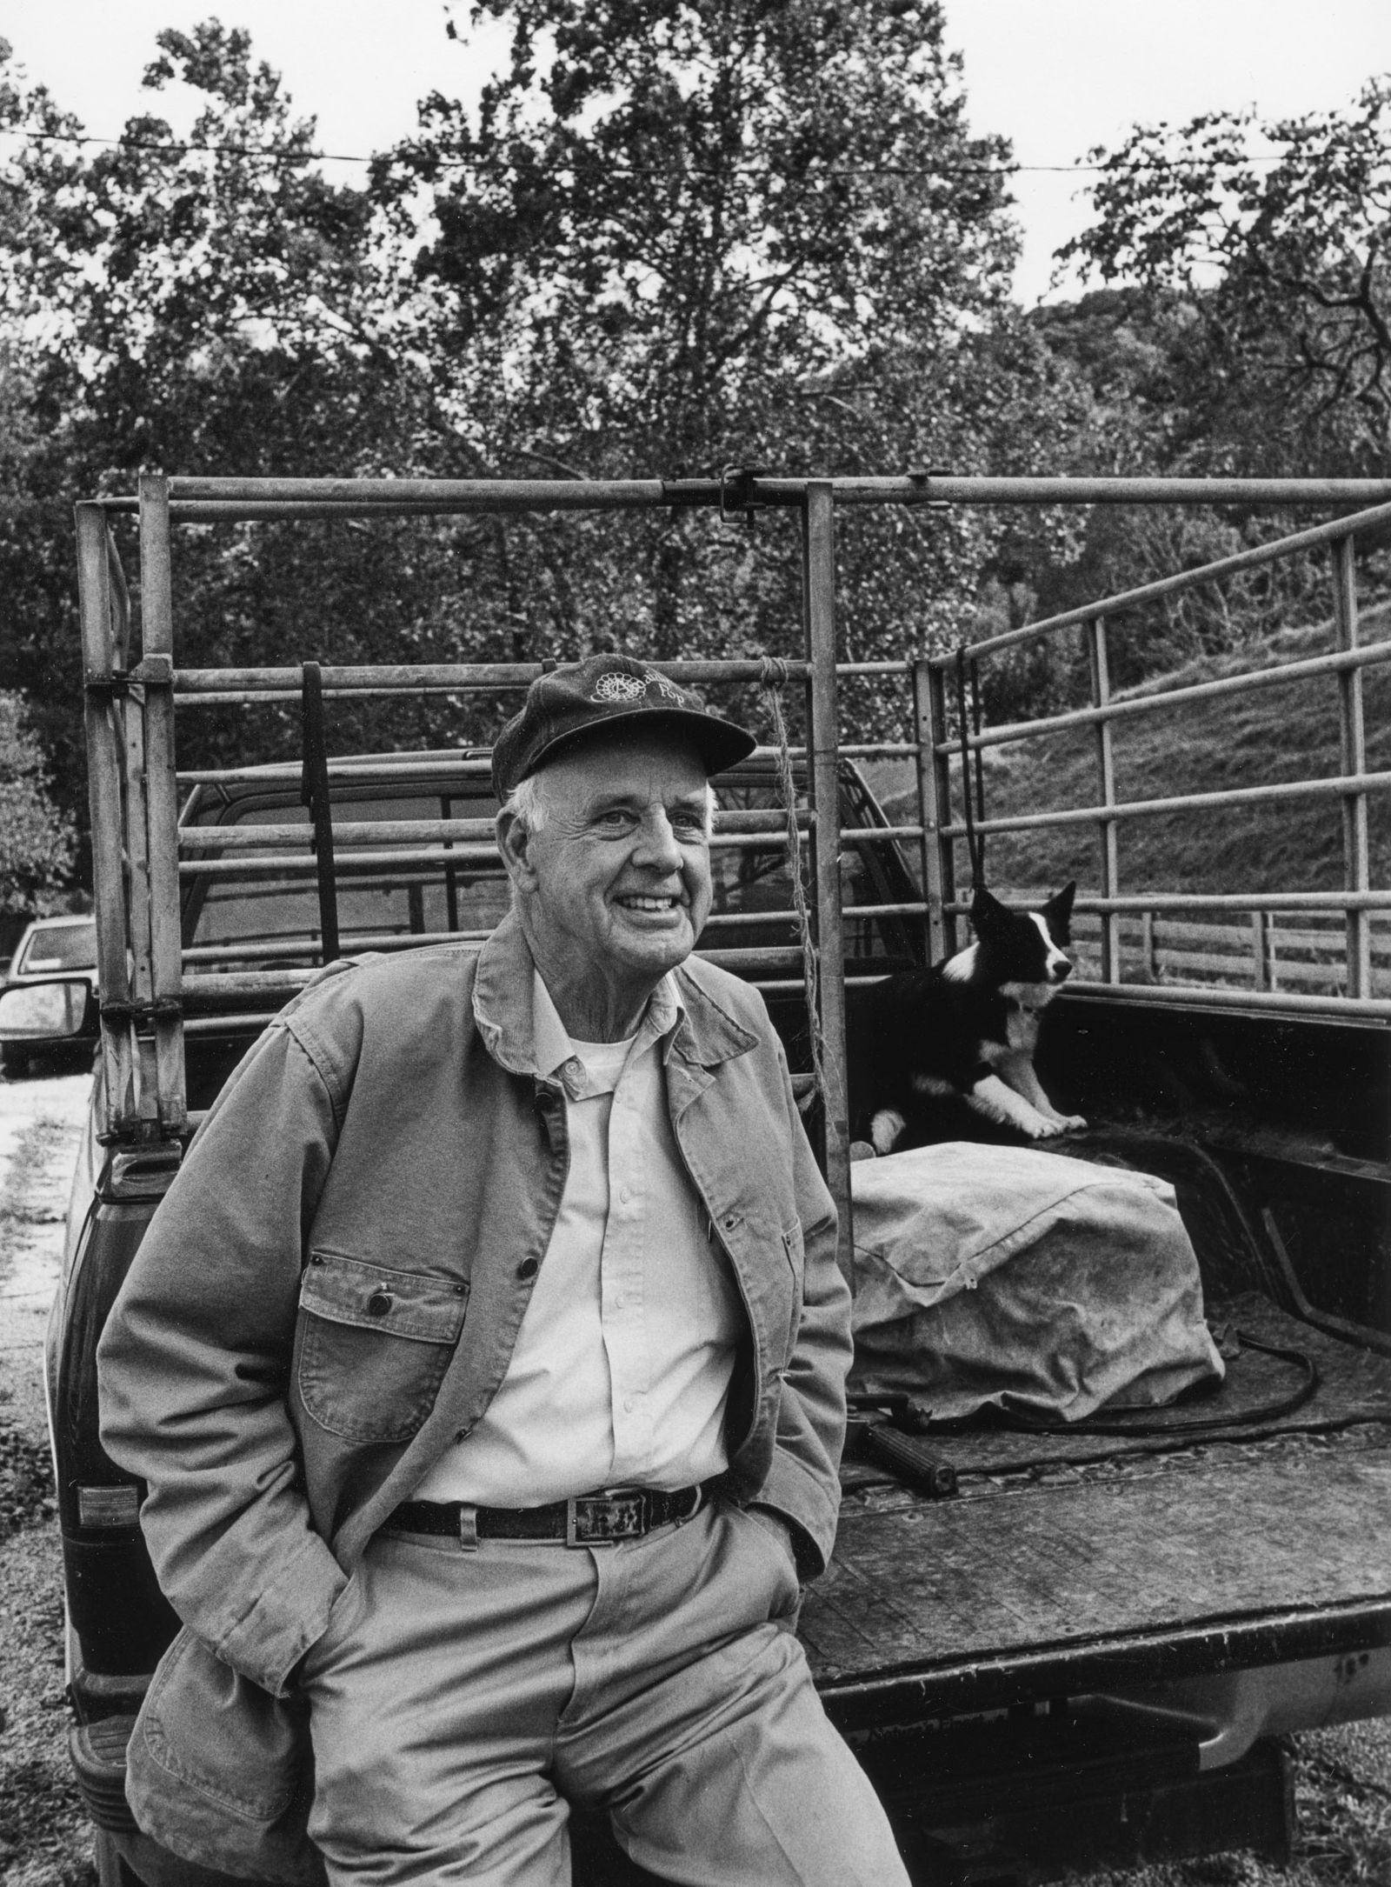
“To cherish what remains of the Earth and to foster its renewal is our only legitimate hope of survival.”
-Wendell Berry

Slide 9
The Wild Geese, Wendell Berry
Horseback on Sunday morning,
harvest over, we taste persimmon and wild grape, sharp sweet of summer's end.
In time's maze over fall fields, we name names that went west from here, names that rest on graves.
We open
a persimmon seed to find the tree
that stands in promise, pale, in the seed's marrow.
Geese appear high over us,
pass, and the sky closes. Abandon, as in love or sleep, holds them to their way, clear, in the ancient faith:
What we need is here.
And we pray, not
for new earth or heaven, but to be quiet in heart, and in eye clear.
What we need is here.

Slide 10
The Parables of the Mustard Seed and the Yeast
³¹ He told them another parable: “The kingdom of heaven is like a mustard seed, which a man took and planted in his field. ³² Though it is the smallest of all seeds, yet when it grows, it is the largest of garden plants and becomes a tree, so that the birds come and perch in its branches.”
³³ He told them still another parable: “The kingdom of heaven is like yeast that a woman took and mixed into about sixty pounds^{[b]} of flour until it worked all through the dough.”
Matthew 13:31-33

Slide 11
God of the land, disturb us today.
Disturb the stories we have inherited.
Disturb the ways we have learned to see poverty.
Disturb every theology that blesses abundance for some
while others struggle for a handful of soil.
AMEN.
Prayer by Iziko Lamaqabane

